Slide 1
Enabling HA – DR for Mission Critical Production Systems

Slide 2
Agenda
Foundations of HA and DR Solutions
What are characteristics for High-Availability (HA) & Disaster Recovery (DR) clusters?
Sample HA & DR Architectures
Questions & Discussion

Slide 3
Foundations of High Availability and Disaster Recovery

Slide 4
High Availability & Disaster Recovery
High Availability
“Zero Downtime” administration & maintenance
Data redundancy
Automatic failover
Disaster Recovery
A plan for Business Continuity for “mission-critical” applications
Multi-state redundancy and failover
Backup-Restore for worst case scenario

Slide 5
Foundations of HA and DR
You need to understand and be able to explain that “Can never go down or lose data” has serious monetary consequences and what it really means.
Define in writing your Recovery Time Objective (RTO) and Recovery Point Objective (RPO) in seconds/minutes/hours
These numbers will guide your entire Couchbase architecture and HA/DR solution.
Get management to sign off on these two numbers and plan
With this, you have a target to hit and justification for your architecture and spending
Without this, you have reduced leverage in management conversations and may not get what you need

Slide 6
Foundations of HA and DR
Couchbase XDCR is not Disaster Recovery
Disaster Recovery requires a layered approach and overall plan, including testing of that plan.
Each feature of Couchbase we use as part of that plan
If the plan is not in writing, it does not exist.

Slide 7
Intra-Cluster High Availability

Slide 8
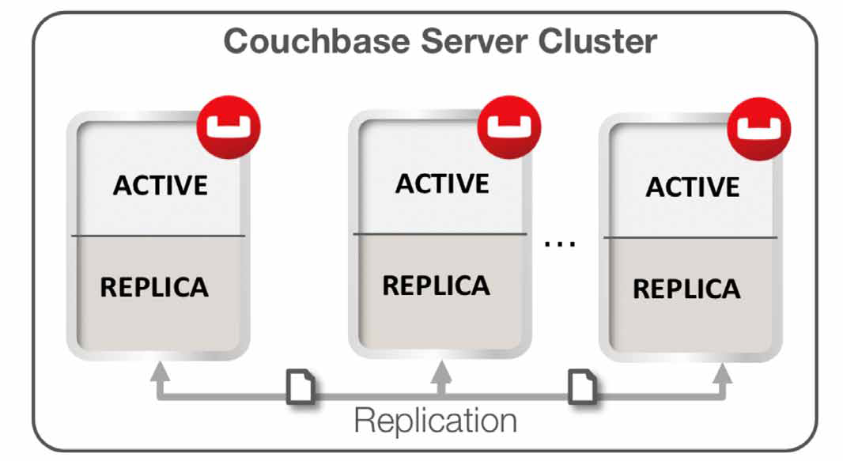
Intra-Cluster Replication
Intra-cluster replication is the process of replicating data on multiple servers within a cluster in order to provide data redundancy.
RAM to RAM replication
Have at least 3 nodes in your cluster and at least 1 replica

Slide 9
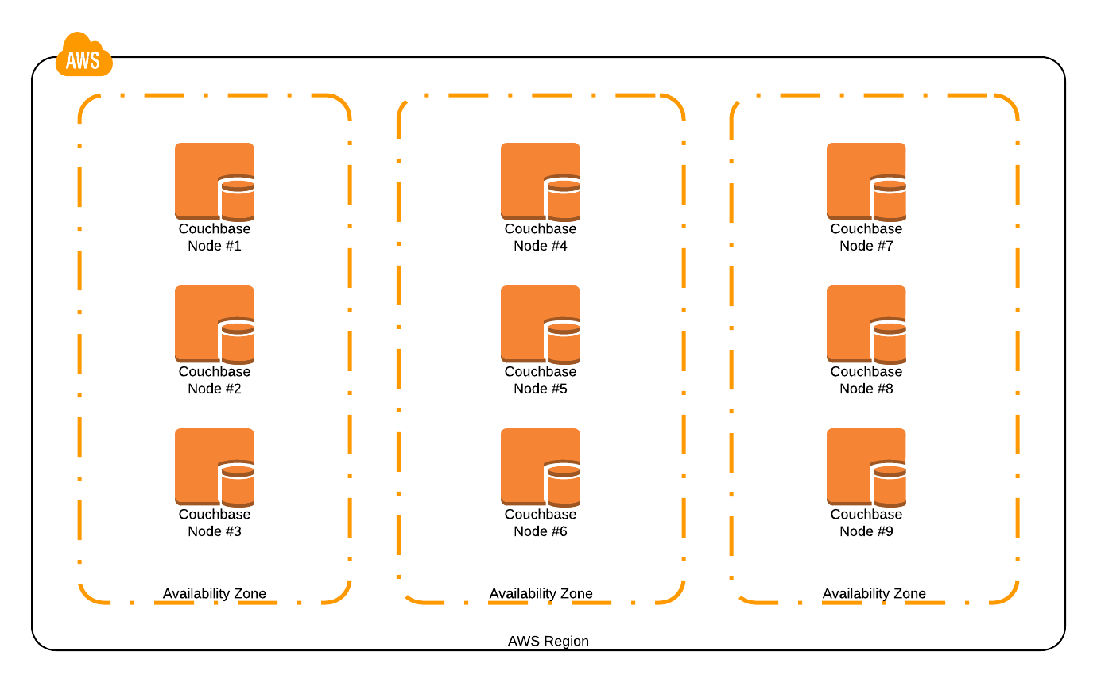
Rack/Zone Awareness
Grouping of servers into Server Groups so that each group represents a physically separate rack/zone
RZA ensures that replica vBuckets are not on the same rack/zone as the active vBuckets
If configured correct, it can withstand entire rack/zone/VMHost going down
Nodes 1, 2, 3 in Zone 1
Nodes 4, 5, 6 in Zone 2
Nodes 7, 8, 9 in Zone 3
Cluster has 2 replicas (3 copies of data). You need a copy of the data per rack/zone
This is a balanced configuration

Slide 10
Application Considerations
Have in your app’s connection string more than one node of your cluster
RPO can dictate your use of Replicate_to in your application
Replica reads
Writes are a sticky point though
Write to a message queue temporarily
Write to a secondary CB cluster and use XDCR to replicate back

Slide 11
How Many Replicas?
Usually best to have 1 replica for clusters 10 nodes are smaller
Above that, you need another replica per node you are might lose.
Likelihood of having concurrent failures goes up as you have more nodes

Slide 12
Inter-Cluster High Availability

Slide 13
XDCR for HA and DR
XDCR can be used as part of a highly available globally load balanced architecture.
XDCR can be part of a DR strategy
Failover to hot/warm standby
Recover to primary cluster using cbrecover tool
Schema design can matter. Normalizing your schema into multiple smaller documents can mean you are pushing smaller changes.
XDCR is by bucket. You do not always need to replicate all data.

Slide 14
Recover a Cluster Using XDCR and cbrecovery
If you lose more than one node in your active cluster, you are not using RZA and you have XDCR, this may be an option.
Recover a cluster from a remote cluster using the cbrecovery tool delivered with Couchbase.
http://docs.couchbase.com/admin/admin/Tasks/tasks-dataRecovery.html

Slide 15
Application Logic + XDCR
Local app in each data center with a Global Load Balancer in front of it all.
Have each local app check timeouts and if it is taking too long, interact with the other data center and it will be replicated back to the local cluster when it is available again.
One customer we have is reported to wait only 5ms before “failing over” like this.

Slide 16
Other HA and DR Considerations

Slide 17
HA During Upgrades and Patches
HA is not just about running under normal circumstances
Your RTO can help dictate how you do this
If you have spare hardware, VMs or instances, it is best to do swap rebalances and keep your capacity and availability
Have in your app’s connection string more than one node of your cluster
RPO can dictate your use of Replicate_to in your application
How many replicas should we have?
Likelihood of having concurrent failures goes up as you have more nodes

Slide 18
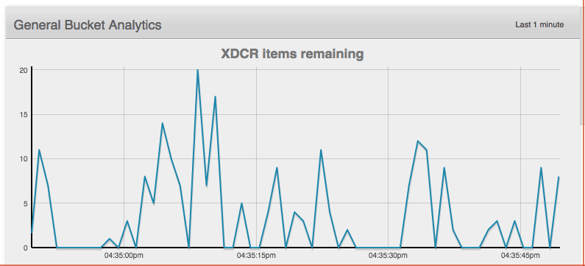
Multi-data center consistency
You might need to monitor the replication queue to make sure the queue is below a specified amount
Perhaps do dual writes to both clusters if this matters

Slide 19
Backups and Restore

Slide 20
Database Backups
If you truly care about RTO/RPO, backups are only for specific scenarios and not your primary DR strategy.
Backups for data corruption and data loss. e.g. app or idiocy
Use cbbackup for full and incremental backups
Test restores with cbrestore on a routine basis
LVM snapshots in 2.x and above
XDCR to a backup cluster, pause the replication and do backups from the backup cluster.

Slide 21
Backup Strategy
The only way to get a fully consistent point in time backup of a running database is by using XDCR to another cluster, pause the stream and then backup that other cluster.
Distributed backups are a hard problem
Whether you use the backups or not will depend on the size of your database, both data and node count, and your RTO/RPO.

Slide 22
cbbackup Strategies
cbbackup to local file system
Easy, but consumes server resources
cbbackup to network file system
Easy, but consumes some server and network resources
cbbackup from central server to remote servers
Requires an extra server and for you to run parallel cbbackups
Requires network and disk resources

Slide 23
Remember to test your DR plan! Thank you.

Slide 24
Get Started with Couchbase Server 4.0: www.couchbase.com/beta
Get Trained on Couchbase: training.couchbase.com

